Slide 1
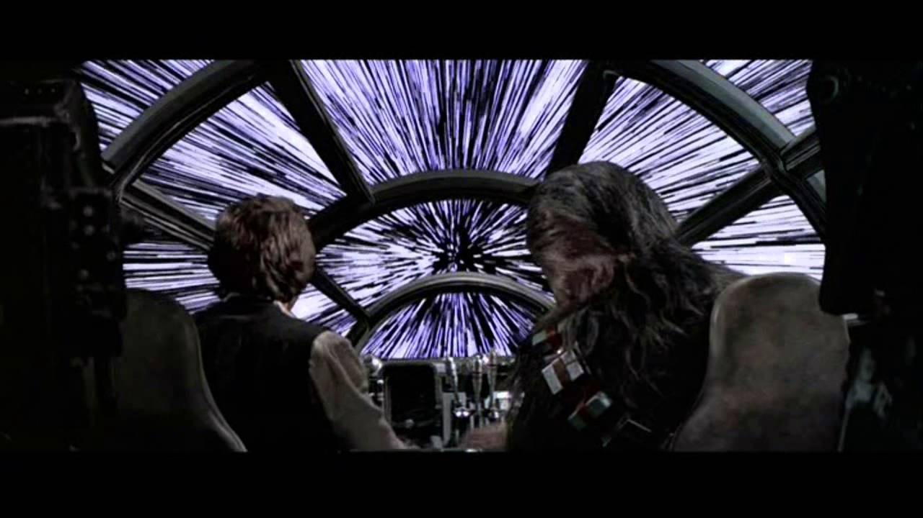
SOEE1475 Statistics and Data Analysis
Lecture 8: Multivariate statistics
Graeme T. Lloyd

Slide 2

Today
The third dimension, and beyond
Ordination
Spherical data

Slide 3
Today
But first…

Slide 4
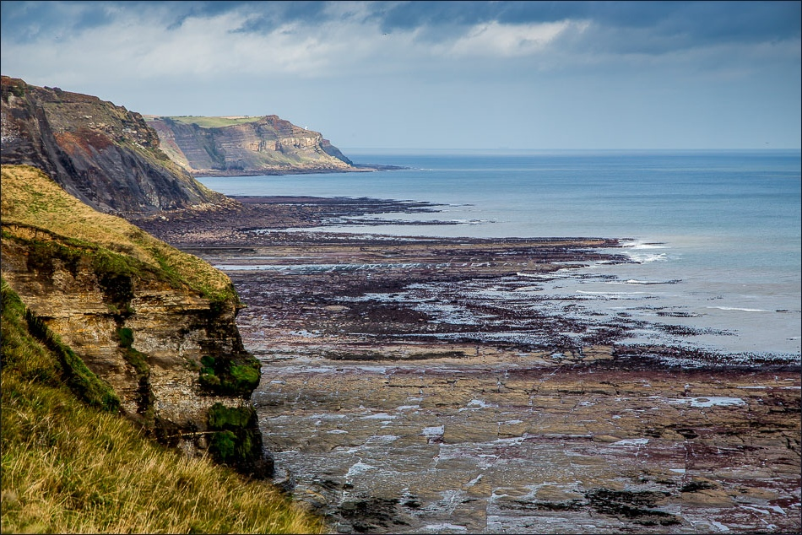
Ammonite quadrat redux
Notes:
Imagine we are actually on a wave cut platform on the Yorkshire coast…

Slide 5
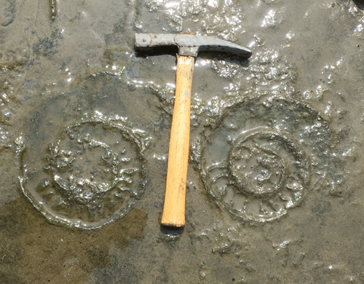
Ammonite quadrat redux
Notes:
…when we look down we see the bedding plane beneath our feet is covered with ammonite fossils. We are going to use these as a data set to ask a variety of scientific questions

Slide 6
Ammonite quadrat redux
1
2
3
4
5
6
7
8
9
10
A
B
C
D
E
10m
F
G
H
I
J
10m
Notes:
Want to measure ammonites but there are many so tsk is split into 100 quadrants – one for each student (plus some leftover)

Slide 7
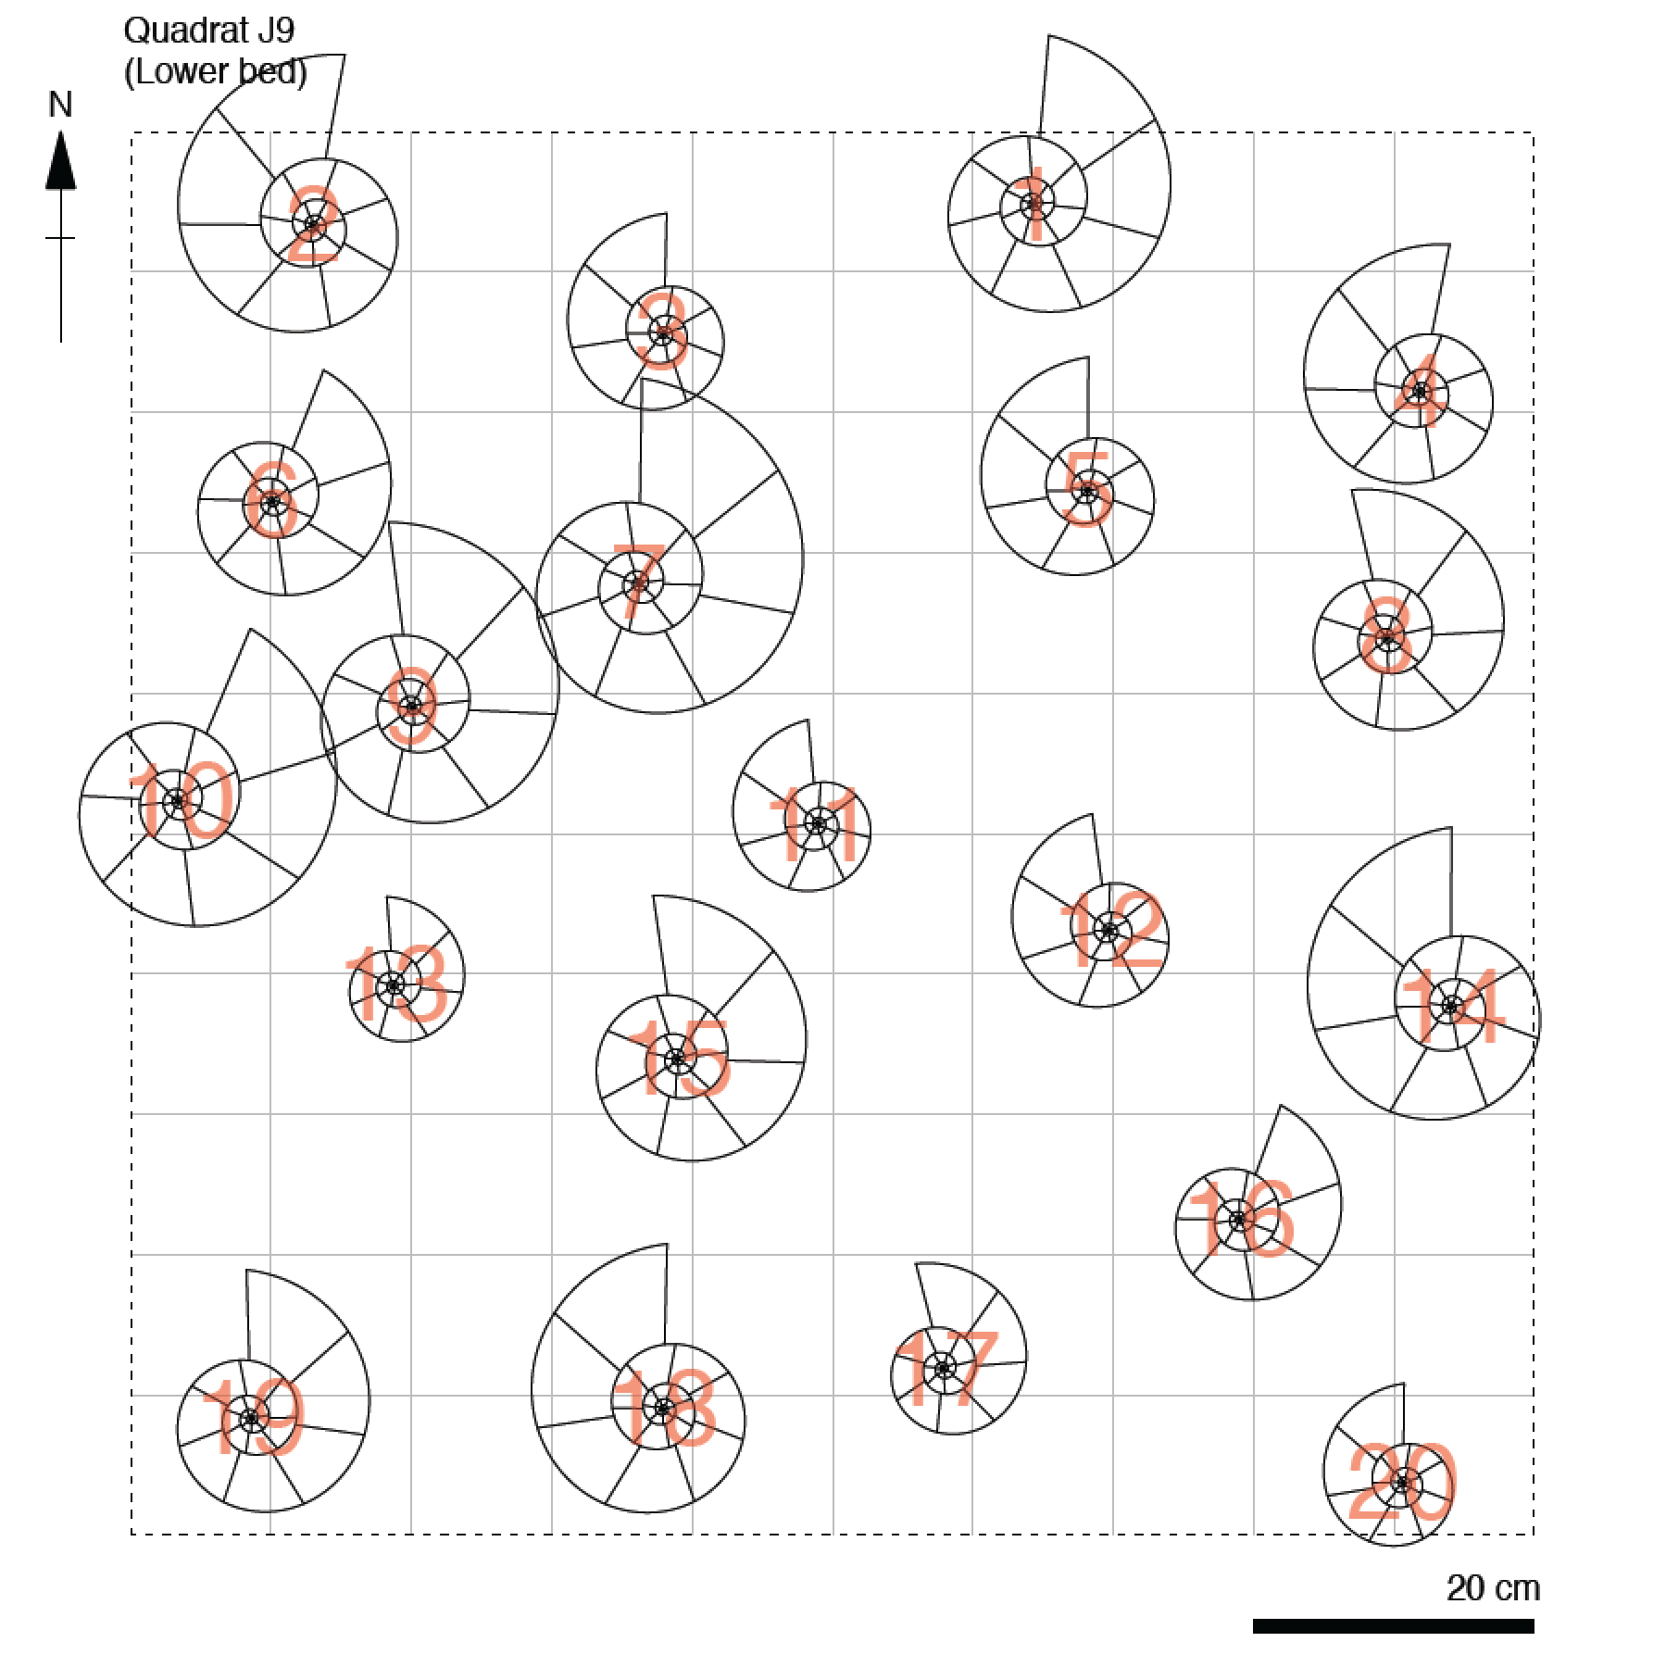
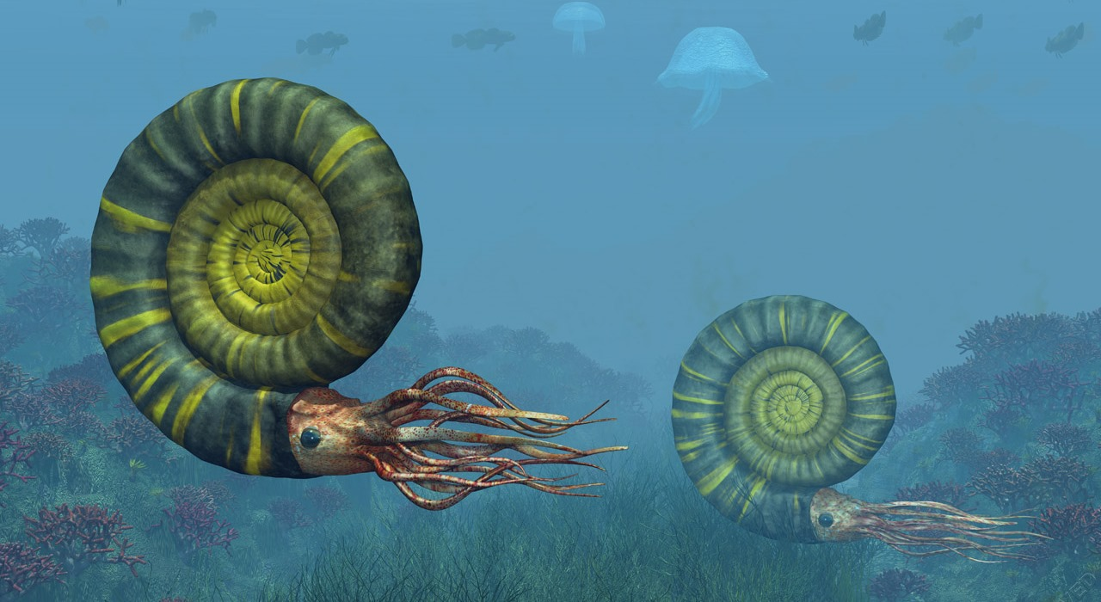
Ammonite quadrat redux
1
2
3
4
5
6
7
8
9
10
A
B
C
D
E
10m
F
G
H
I
J
10m
Notes:
Note orientation and scale - essential elements of field diagrams in general

Slide 8
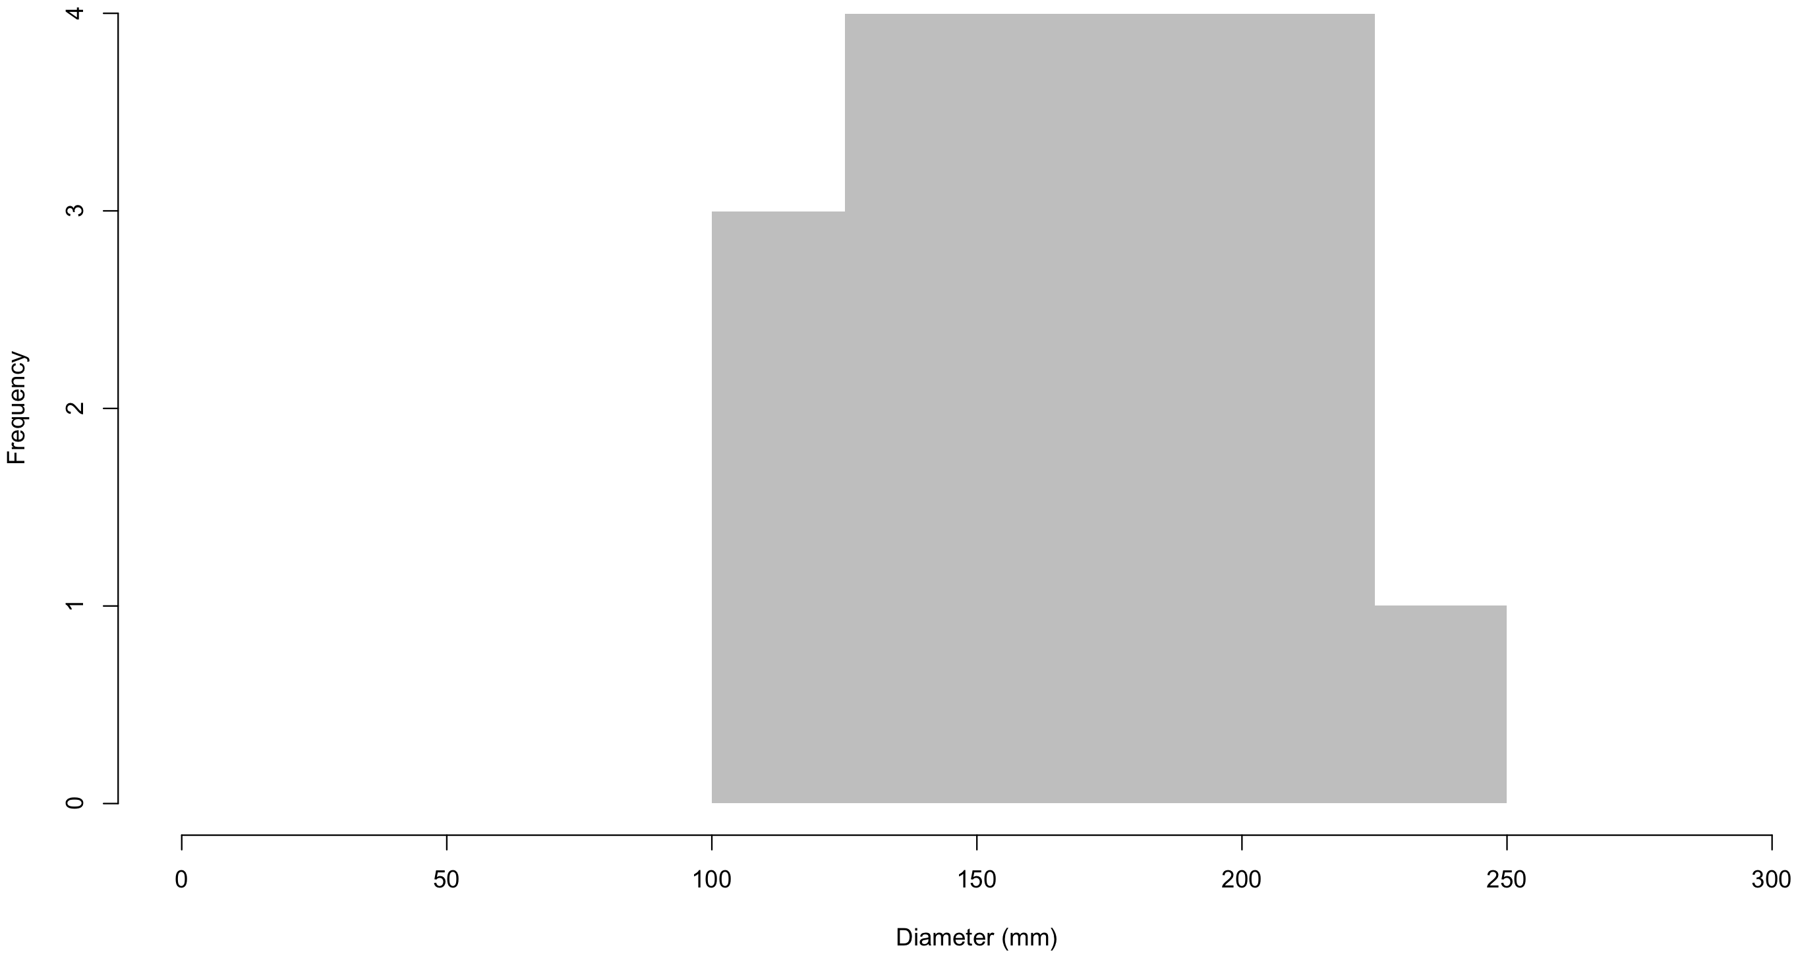
Ammonite quadrat redux

Slide 9
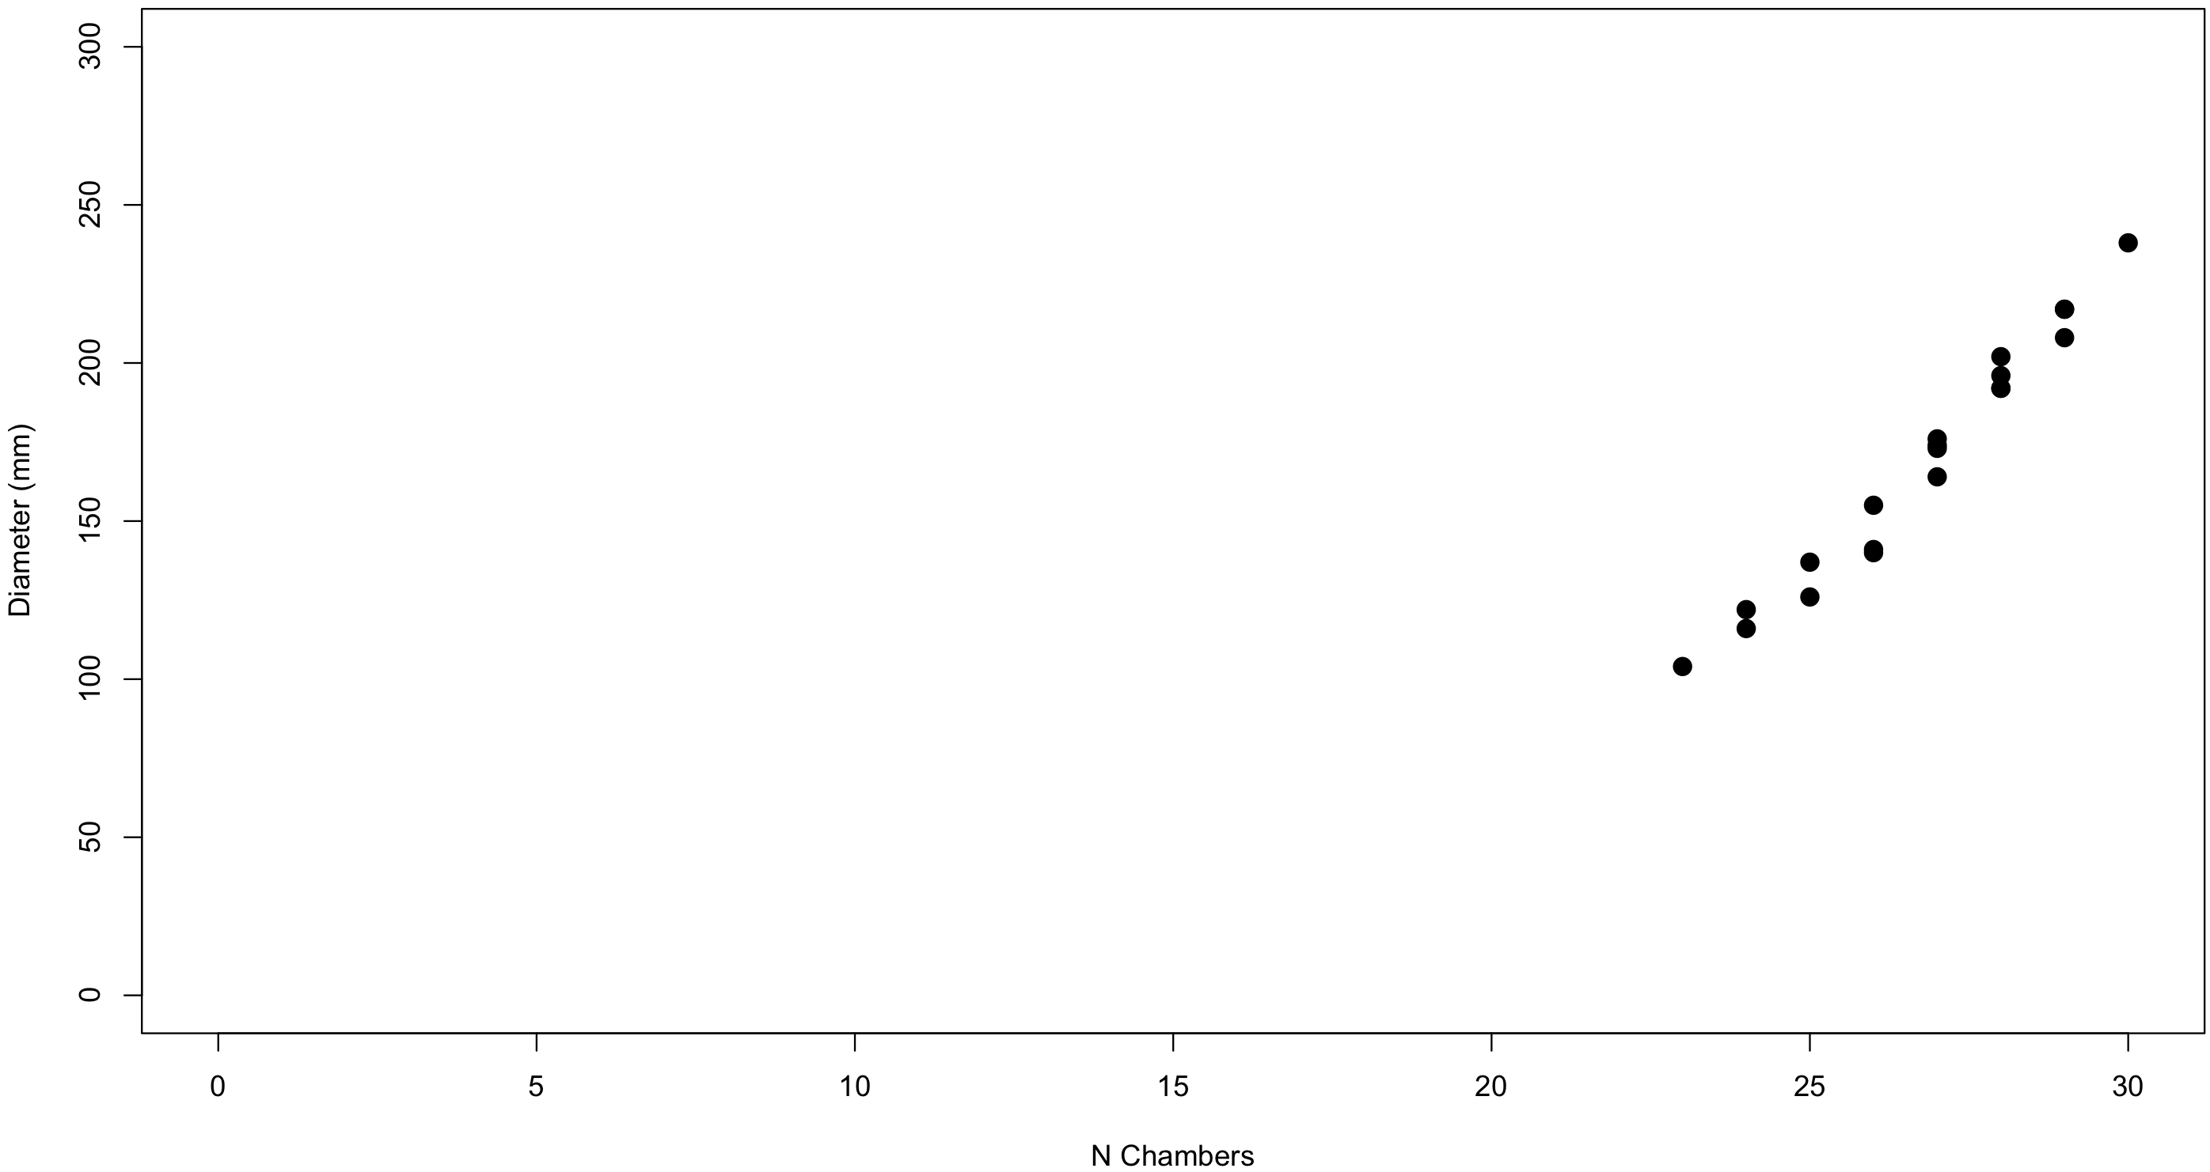
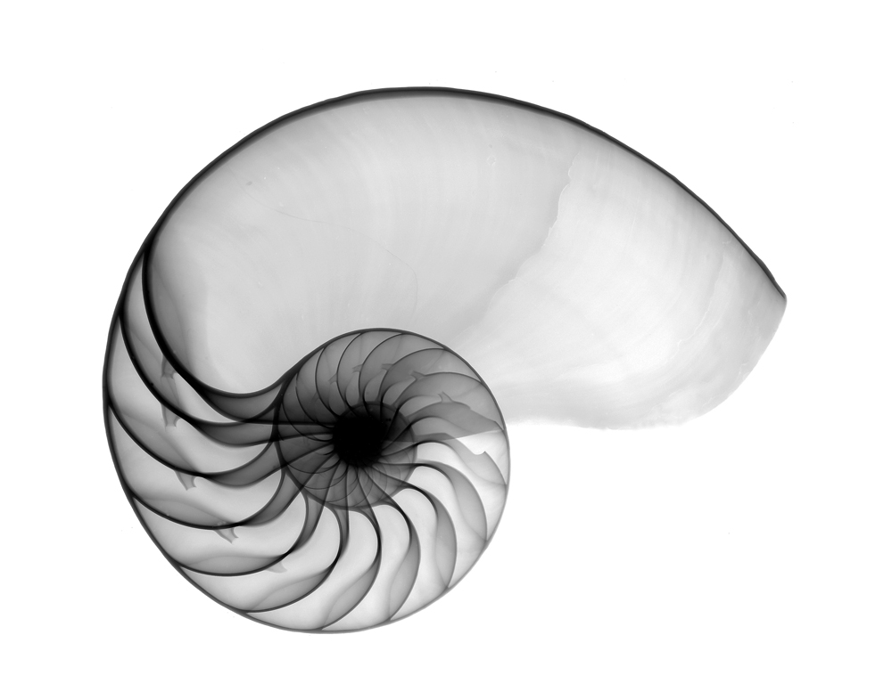
Ammonite quadrat redux

Slide 10
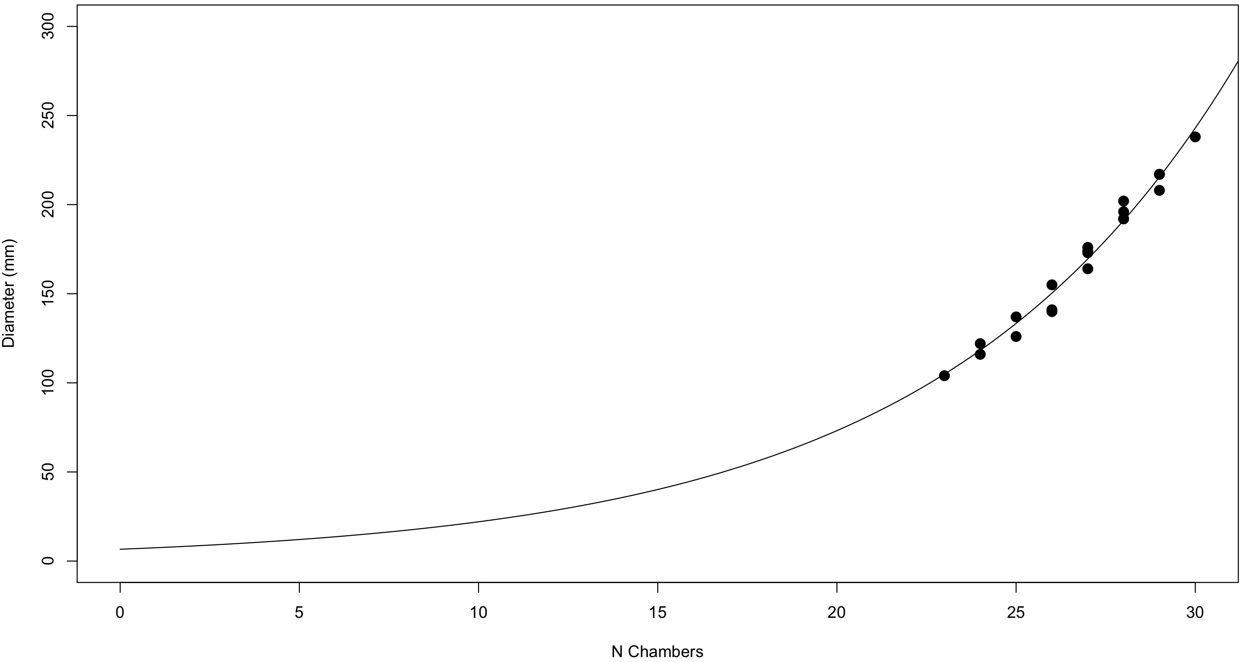
Ammonite quadrat redux

Slide 11
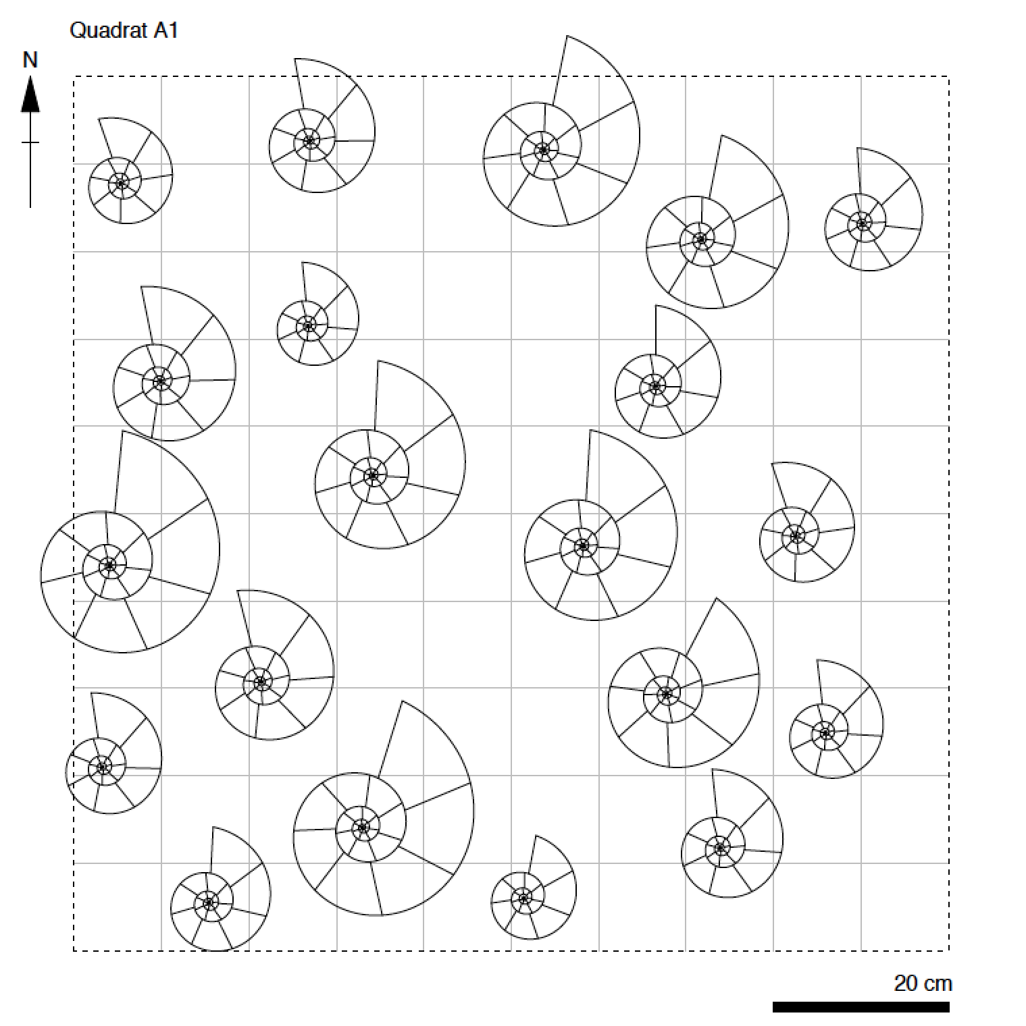
Ammonite quadrat redux
=
Uniform

Slide 12
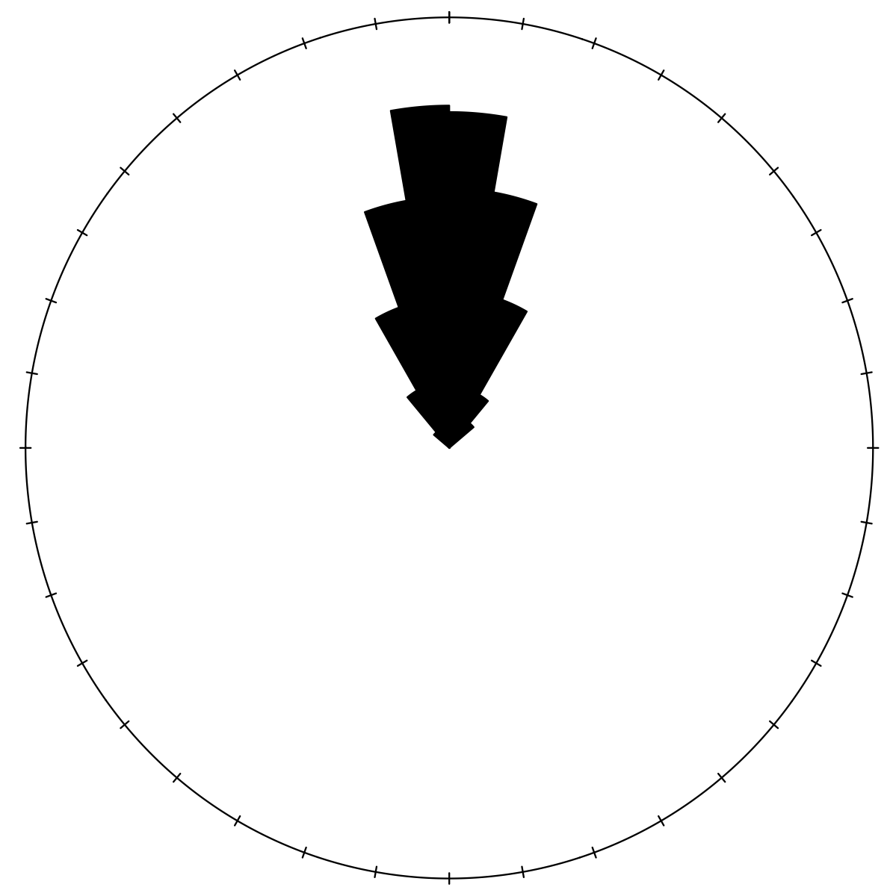
Ammonite quadrat redux

Slide 13
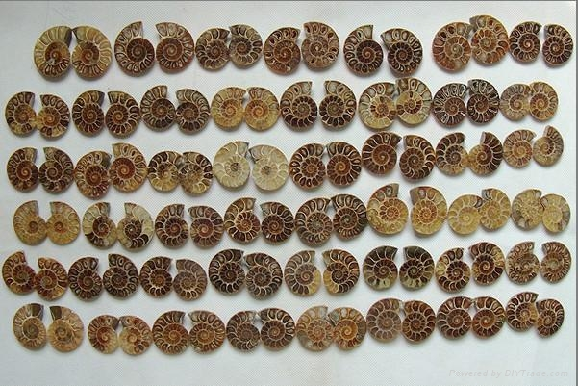
Ammonite quadrat redux
Notes:
Ask class if instead of dropping quadrats and measuring in situ if we had gone to the commercial collectors shop and bought some ammonites what analyses could we do? (I.e., point out issues of biased sampling and mainly that a lot of information is lost once we take a fossil out of the ground).

Slide 14
Ammonite quadrat redux
Back to multivariate statistics…

Slide 15

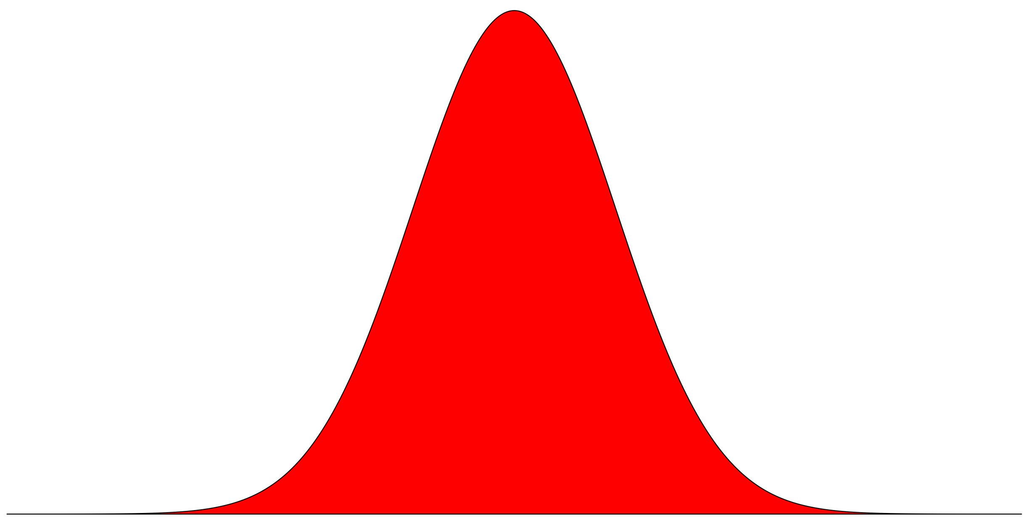
Univariate data
Population
Sample
Notes:
With univariate data we ar interested in what we can say about the population from the sample

Slide 16
Bivariate data
y
x
Notes:
With bivariate data we are interested in the relationships between two variables

Slide 17
Multivariate data
Notes:
Multivariate data is different, although we have already encountered some aspects of it before.

Slide 18
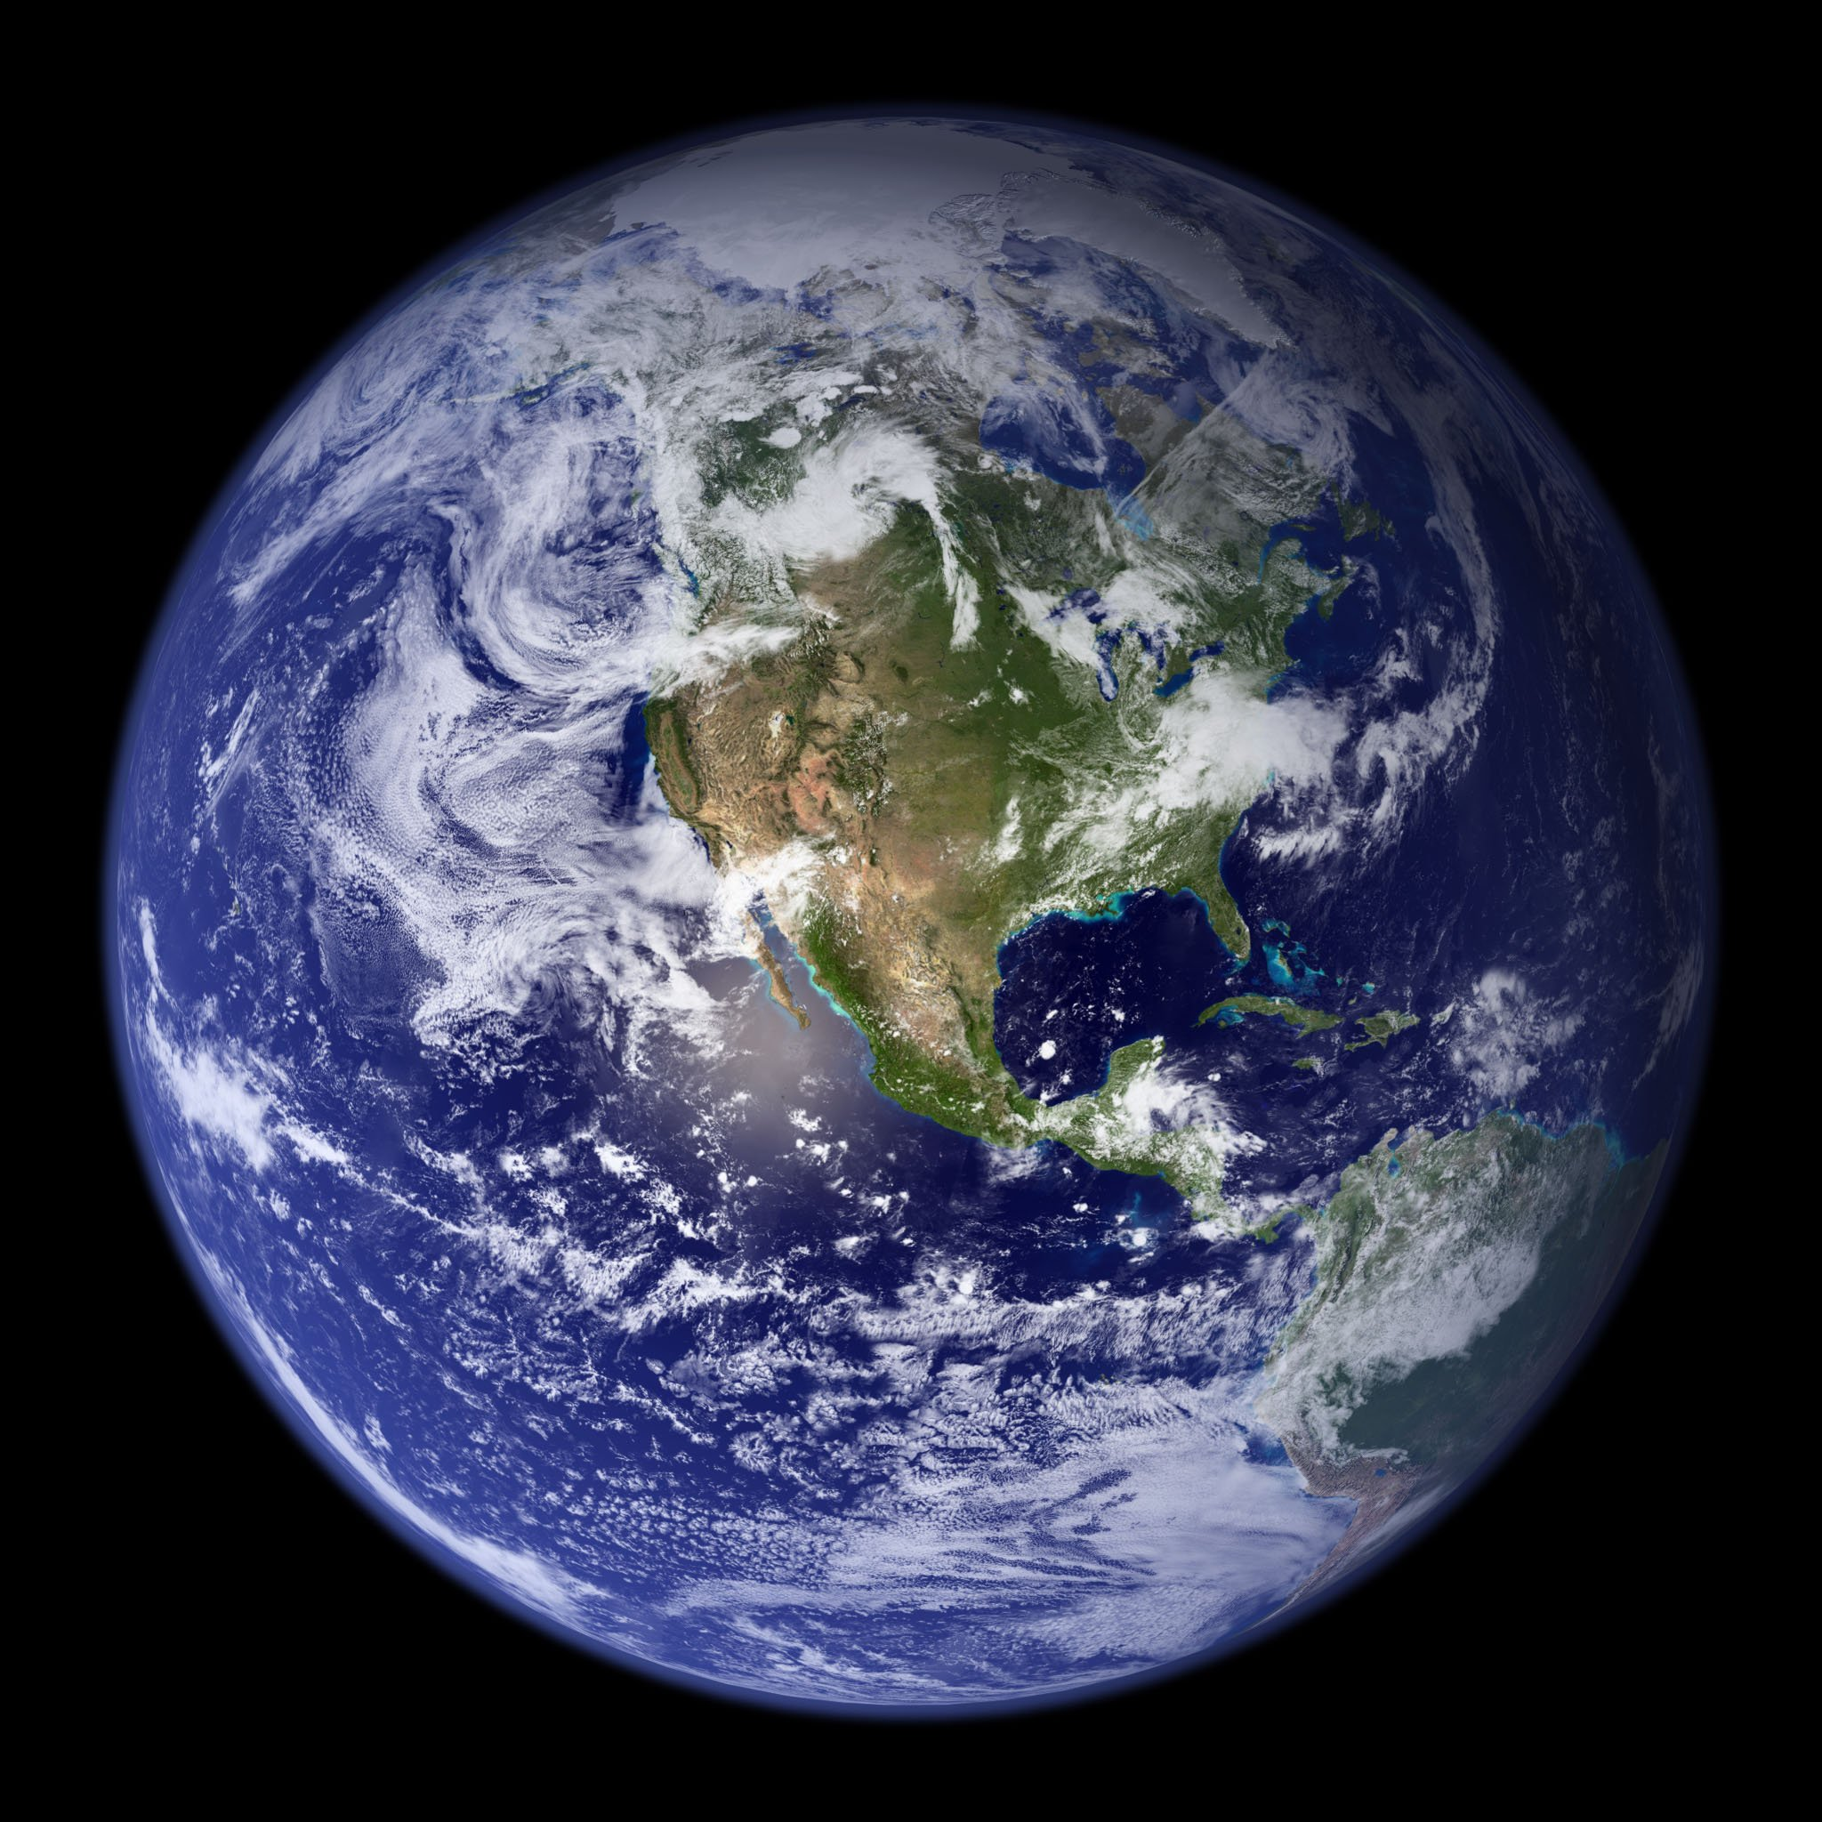
Multivariate data
Notes:
For example, if we wanted to model the temperature of various points on the Earth’s surface we could use a more complex regression equation with multiple explanatory variables, such as latitude and season.

Slide 19
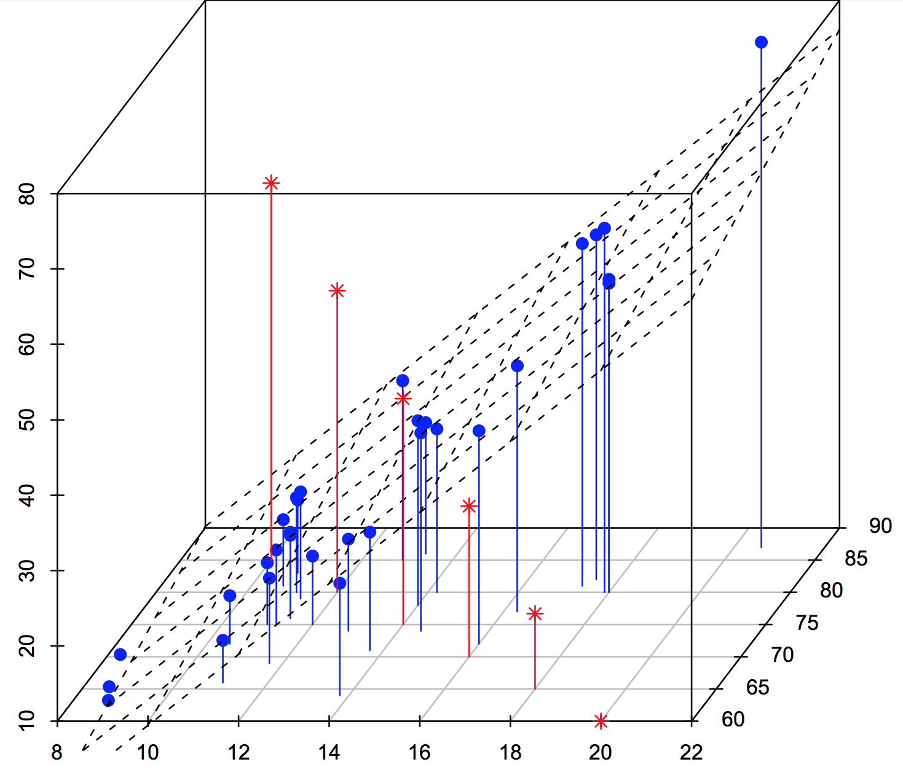
Multivariate data
z
y
x
Notes:
Similarlly, we already encountered that we can add additional regression terms to fit planes or more complex structures to 3D data.

Slide 20
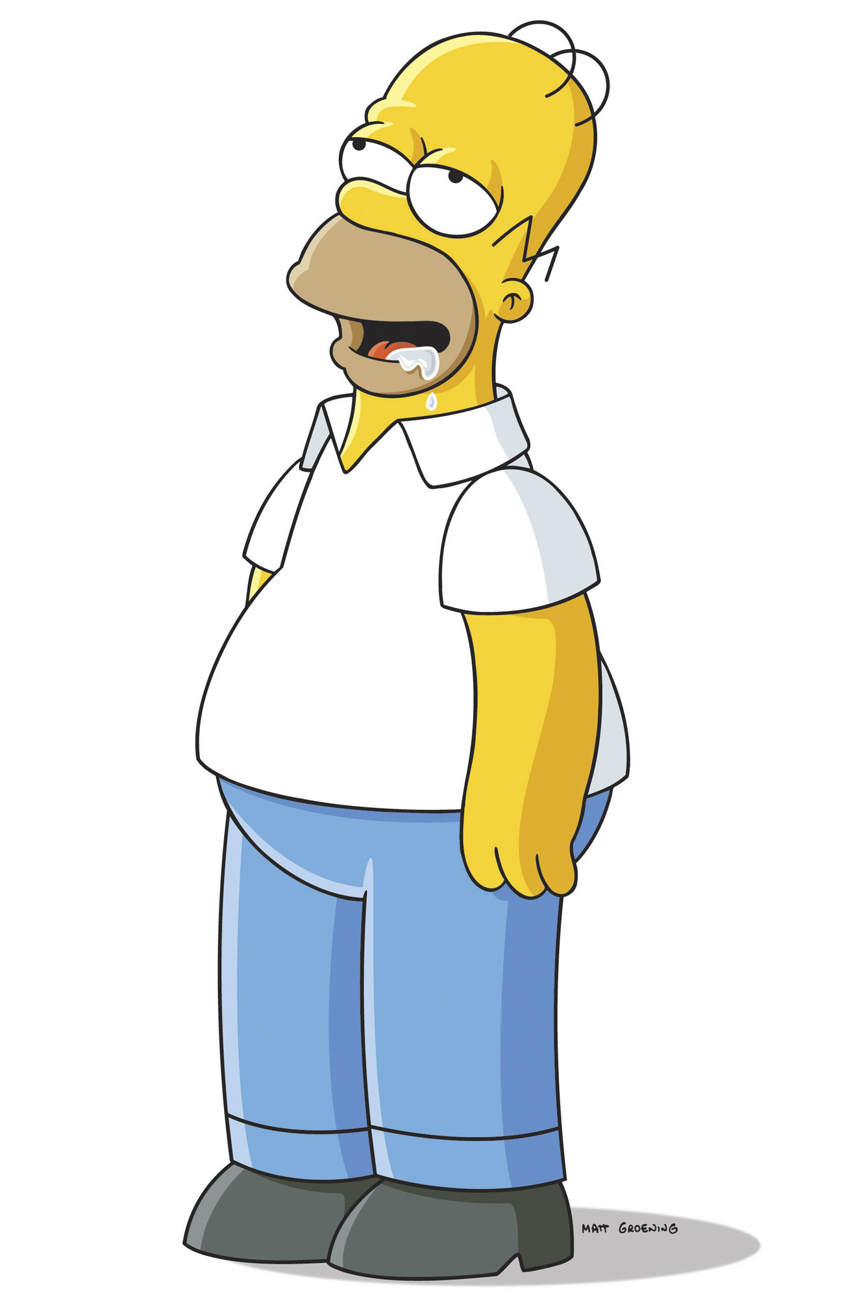
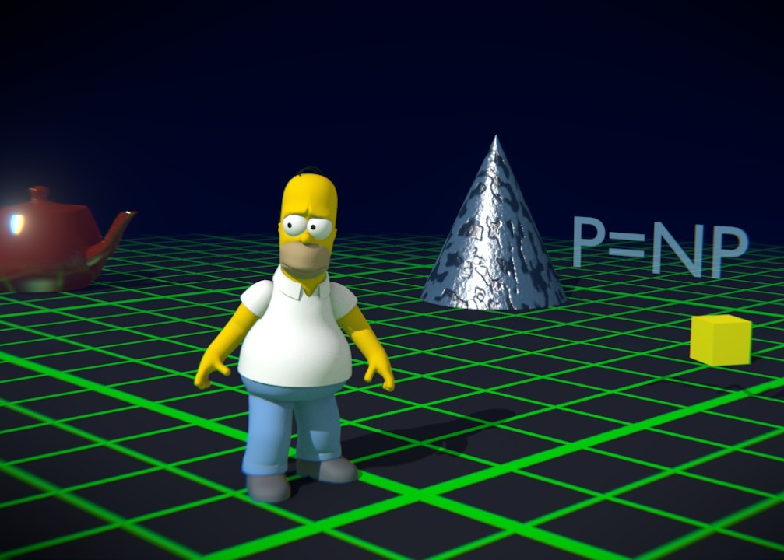
Multivariate data
Notes:
However, the main way in which we will consider multivariate data is something called ordination – the goal of which is to reduce the dimensionality of a data set to make it easier to visualise and handle numerically.

Slide 21
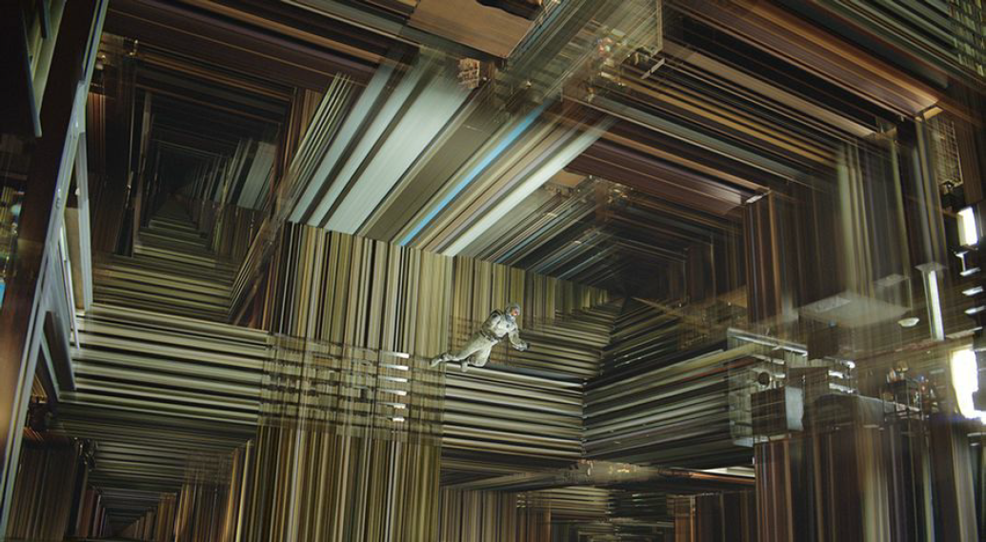
How many dimensions?
Notes:
A place to start might be to think abut the number of physical dimensions in our universe. Ask class how many there are. They will likely say three, but physics suggests otherwise. Of course, we may only be able to perceive three and additionally we appear to be unable to physically traverse the other possible dimensions. However, we can ask a different question of how many dimensions can conceptually exist.and hence be dealt with mathematically.

Slide 22
Triangles
Notes:
A good place to start with this is to think of the humble triangle

Slide 23
Triangles
Notes:
Imagine we have a simple right-angled triangle.

Slide 24
Triangles
c
a
b
Notes:
We can label it’s edges.

Slide 25
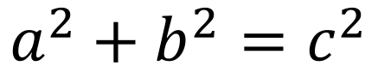
Triangles
$$a^{2}+b^{2}=c^{2}$$
c
a
b
Notes:
And state their relationship using Pythagoras.

Slide 26
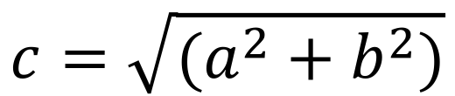
Triangles
$$a^{2}+b^{2}=c^{2}$$
$$c=\sqrt{(a^{2}+b^{2})}$$
c
a
b
Notes:
We could rearrange this to solve for the hypotenuse too.

Slide 27
Triangles
x₁,y₁
$$a^{2}+b^{2}=c^{2}$$
$$c=\sqrt{(a^{2}+b^{2})}$$
c
x₂,y₂
Notes:
What we have actually done here is come up with a general formula for the distance between two points in a two-dimensional space.

Slide 28
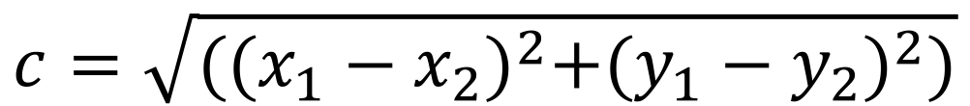
Triangles
x₁,y₁
$$a^{2}+b^{2}=c^{2}$$
$$c=\sqrt{(a^{2}+b^{2})}$$
c
$$c=\sqrt{{((x_{1}−x_{2})}^{2}+{(y_{1}−y_{2})}^{2})}$$
x₂,y₂
Notes:
This we can reframe our equation as the difference along the x-axis and the difference along the y-axis.

Slide 29
Triangles
x₁,y₁,z₁
c
x₂,y₂,z₂
Notes:
What about a triangle in 3D space? Imagine here that the left-hand side of the triangle recedes io the distance.

Slide 30
Triangles
$$c=\sqrt{{((x_{1}−x_{2})}^{2}+{(y_{1}−y_{2})}^{2}+{(z_{1}−z_{2})}^{2})}$$
x₁,y₁,z₁
c
x₂,y₂,z₂
Notes:
Turns out this isn’t hard at all. We can just add another term into our equation (here z).

Slide 31
Triangles
Notes:
What about in four-dimensions? Well we can no longer even really attempt to plot our triangle.

Slide 32
Triangles
$$c=\sqrt{{((x_{1}−x_{2})}^{2}+{(y_{1}−y_{2})}^{2}+{(z_{1}−z_{2})}^{2}+{(α_{1}−α_{2})}^{2})}$$
Notes:
But we can still solve our equation. And we can continue to do this for effectively infinite dimensions (although it gets awkward to keep picking letters!)

Slide 33
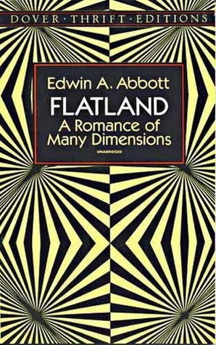
Triangles
Notes:
So mathematically we can deal with as many dimension as we want, but thinking in higher dimensions can hurt our brains, and plotting becomes impossible – remember Lesson #1! Ask class if they read Flatland and if not urge them to do so - can really help to imagine higher dimensions by imagining lower dimensions.

Slide 34
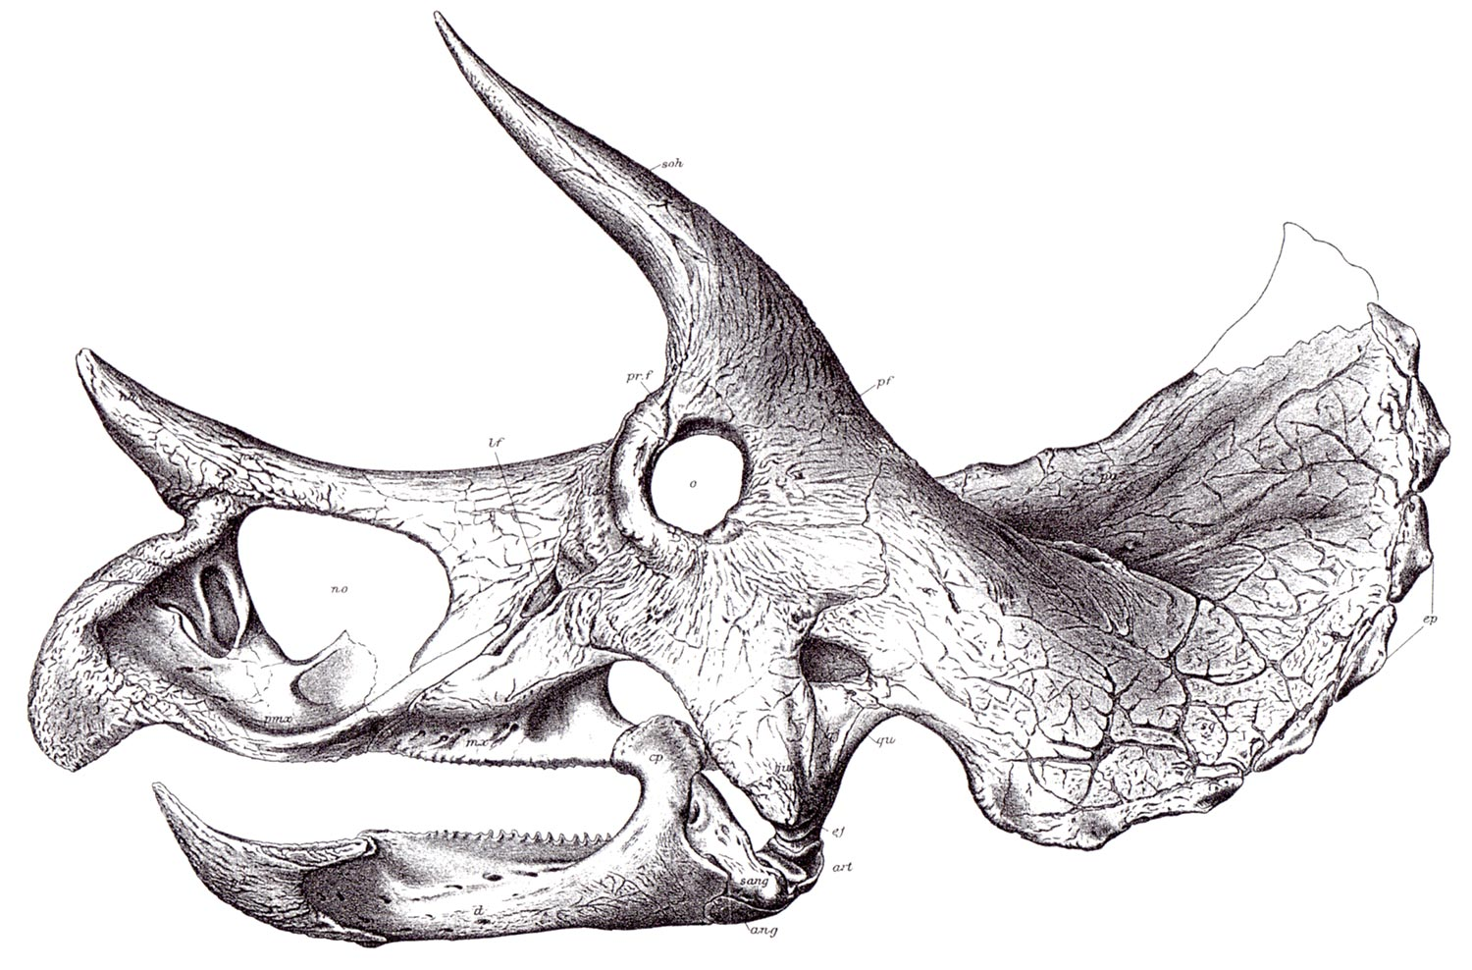
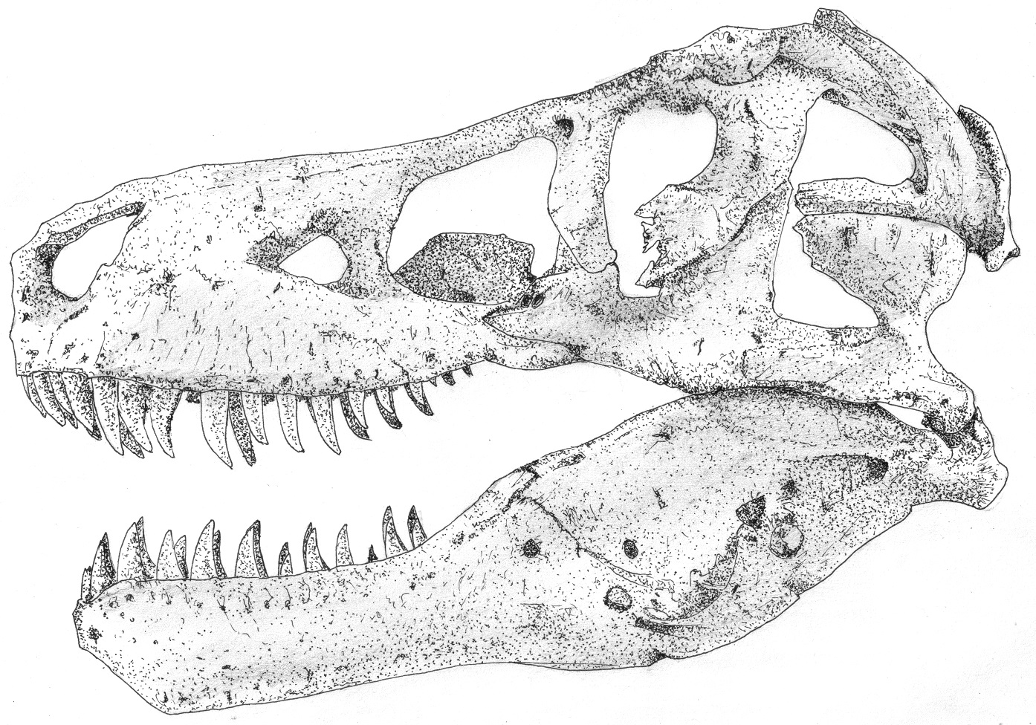
Spot the difference
Triceratops horridus
Tyrannosaurus rex
Notes:
But why do we need all these dimensions. One reason is that to understand all the variation in complex systems requires lots of different kinds of measurements. For example, ask the class what differences they can spot here. Then ask how many more they think a dinosaur paleontologist would list. How would we plot them?

Slide 35
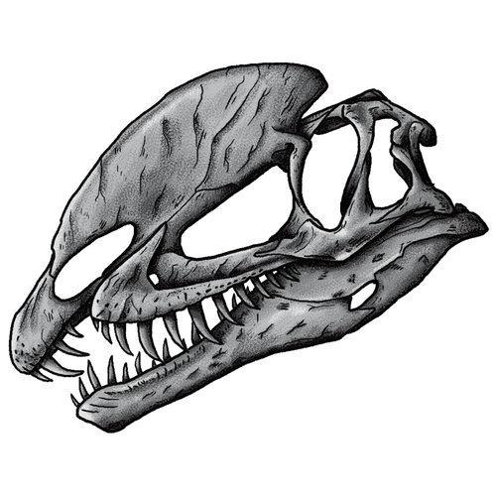
Spot the difference
Triceratops horridus
Tyrannosaurus rex
Dilophosaurus wetherilli
Notes:
What if we added a third dinosaur? Could we place it in relative proximity to the other two?

Slide 36
Exercise

Slide 37
Exercise – trivia time!

Slide 38
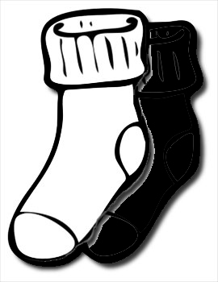
Exercise – trivia time!
A drawer contains 12 white socks and 12 black socks. If you pick two at random what is the probability they are a matching pair? (Give your answer as a fraction)

Slide 39
Exercise – trivia time!
What is the median of the integers 1 to 999?
1 2 3 4 5 6 7 8 9 10 11 12 13 14 15 16 17 18 19 20 21 22 23 24 25 26 27 28 29 30 31 32 33 34 35 36 37 38 39 40 41 42 43 44 45 46 47 48 49 50 51 52 53 54 55 56 57 58 59 60 61 62 63 64 65 66 67 68 69 70 71 72 73 74 75 76 77 78 79 80 81 82 83 84 85 86 87 88 89 90 91 92 93 94 95 96 97 98 99 100 101 102 103 104 105 106 107 108 109 110 111 112 113 114 115 116 117 118 119 120 121 122 123 124 125 126 127 128 129 130 131 132 133 134 135 136 137 138 139 140 141 142 143 144 145 146 147 148 149 150 151 152 153 154 155 156 157 158 159 160 161 162 163 164 165 166 167 168 169 170 171 172 173 174 175 176 177 178 179 180 181 182 183 184 185 186 187 188 189 190 191 192 193 194 195 196 197 198 199 200 201 202 203 204 205 206 207 208 209 210 211 212 213 214 215 216 217 218 219 220 221 222 223 224 225 226 227 228 229 230 231 232 233 234 235 236 237 238 239 240 241 242 243 244 245 246 247 248 249 250 251 252 253 254 255 256 257 258 259 260 261 262 263 264 265 266 267 268 269 270 271 272 273 274 275 276 277 278 279 280 281 282 283 284 285 286 287 288 289 290 291 292 293 294 295 296 297 298 299 300 301 302 303 304 305 306 307 308 309 310 311 312 313 314 315 316 317 318 319 320 321 322 323 324 325 326 327 328 329 330 331 332 333 334 335 336 337 338 339 340 341 342 343 344 345 346 347 348 349 350 351 352 353 354 355 356 357 358 359 360 361 362 363 364 365 366 367 368 369 370 371 372 373 374 375 376 377 378 379 380 381 382 383 384 385 386 387 388 389 390 391 392 393 394 395 396 397 398 399 400 401 402 403 404 405 406 407 408 409 410 411 412 413 414 415 416 417 418 419 420 421 422 423 424 425 426 427 428 429 430 431 432 433 434 435 436 437 438 439 440 441 442 443 444 445 446 447 448 449 450 451 452 453 454 455 456 457 458 459 460 461 462 463 464 465 466 467 468 469 470 471 472 473 474 475 476 477 478 479 480 481 482 483 484 485 486 487 488 489 490 491 492 493 494 495 496 497 498 499 500 501 502 503 504 505 506 507 508 509 510 511 512 513 514 515 516 517 518 519 520 521 522 523 524 525 526 527 528 529 530 531 532 533 534 535 536 537 538 539 540 541 542 543 544 545 546 547 548 549 550 551 552 553 554 555 556 557 558 559 560 561 562 563 564 565 566 567 568 569 570 571 572 573 574 575 576 577 578 579 580 581 582 583 584 585 586 587 588 589 590 591 592 593 594 595 596 597 598 599 600 601 602 603 604 605 606 607 608 609 610 611 612 613 614 615 616 617 618 619 620 621 622 623 624 625 626 627 628 629 630 631 632 633 634 635 636 637 638 639 640 641 642 643 644 645 646 647 648 649 650 651 652 653 654 655 656 657 658 659 660 661 662 663 664 665 666 667 668 669 670 671 672 673 674 675 676 677 678 679 680 681 682 683 684 685 686 687 688 689 690 691 692 693 694 695 696 697 698 699 700 701 702 703 704 705 706 707 708 709 710 711 712 713 714 715 716 717 718 719 720 721 722 723 724 725 726 727 728 729 730 731 732 733 734 735 736 737 738 739 740 741 742 743 744 745 746 747 748 749 750 751 752 753 754 755 756 757 758 759 760 761 762 763 764 765 766 767 768 769 770 771 772 773 774 775 776 777 778 779 780 781 782 783 784 785 786 787 788 789 790 791 792 793 794 795 796 797 798 799 800 801 802 803 804 805 806 807 808 809 810 811 812 813 814 815 816 817 818 819 820 821 822 823 824 825 826 827 828 829 830 831 832 833 834 835 836 837 838 839 840 841 842 843 844 845 846 847 848 849 850 851 852 853 854 855 856 857 858 859 860 861 862 863 864 865 866 867 868 869 870 871 872 873 874 875 876 877 878 879 880 881 882 883 884 885 886 887 888 889 890 891 892 893 894 895 896 897 898 899 900 901 902 903 904 905 906 907 908 909 910 911 912 913 914 915 916 917 918 919 920 921 922 923 924 925 926 927 928 929 930 931 932 933 934 935 936 937 938 939 940 941 942 943 944 945 946 947 948 949 950 951 952 953 954 955 956 957 958 959 960 961 962 963 964 965 966 967 968 969 970 971 972 973 974 975 976 977 978 979 980 981 982 983 984 985 986 987 988 989 990 991 992 993 994 995 996 997 998 999

Slide 40
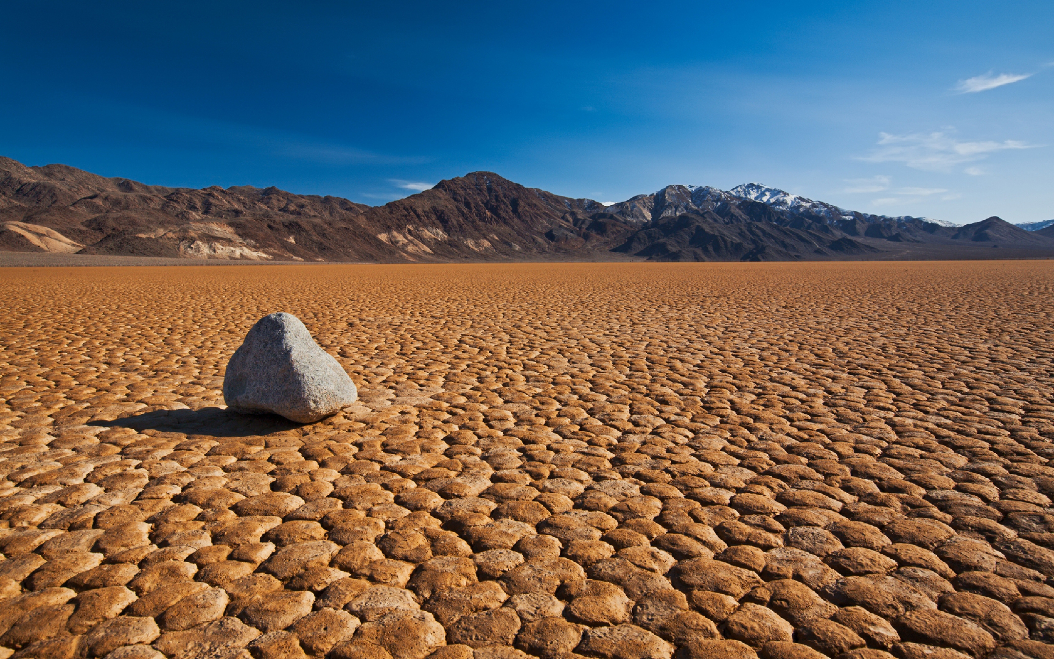

Exercise – trivia time!
What problem might explain a strong negative correlation between number of pirates and global temperature?

Slide 41
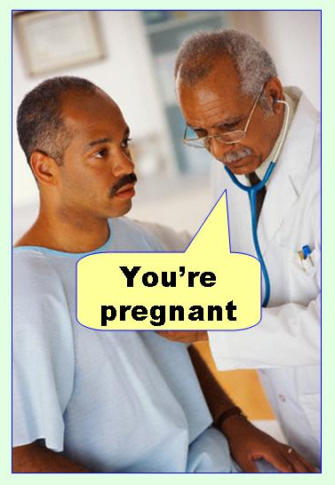
Exercise – trivia time!
If you performed 100 statistical tests using an alpha of 0.02 how many times would you expect to falsely reject the null?

Slide 42
Exercise – trivia time!
What is the maximum realizable value for the Nearest Neighbour Index (R) in two-dimensional space?

Slide 43
Exercise – trivia time!
Look at the following transition probability matrix. At t₀ the system is in state X. What state will it be in at t₀ + 7?
X
Y
Z
X
1
0
0
Y
0
1
0
Z
0
0
1

Slide 44
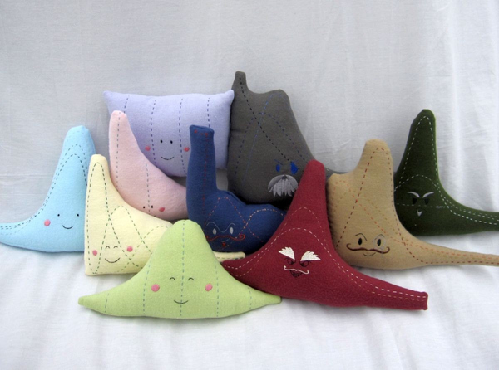
Exercise – trivia time!
A von Mises with a Kappa of zero is the circular equivalent of which univariate probability distribution?

Slide 45
Exercise – trivia time!
A drawer contains 12 white socks and 12 black socks. If you pick two at random what is the probability they are a matching pair? (Give your answer as a fraction)
What is the median of the integers 1 to 999?
What problem might explain a strong negative correlation between number of pirates and global temperature?
If you performed 100 statistical tests using an alpha of 0.02 how many times would you expect to falsely reject the null?
What is the maximum realizable value for the Nearest Neighbour Index (R) in two-dimensional space?
Look at the following transition probability matrix. At t₀ the system is in state X. What state will it be in at t₀ + 7?
A von Mises with a Kappa of zero is the circular equivalent of which univariate probability distribution?
X
Y
Z
X
1
0
0
Y
0
1
0
Z
0
0
1

Slide 46
Exercise – trivia time!

Slide 47
Exercise – trivia time!
11/23
500
Temporal autocorrelation
2
2.15
State X
Continuous uniform
X
Y
Z

Slide 48
Exercise – trivia time!
Tiebreaker!
Notes:
Rules: fastest to get right answer wins. Opportunity to steal before giving a second answer. Question: A raffle is hedl with twenty tickets, numbered 1 to 20. A single winning ticket is drawn. What is the probability its number is a multiple of three OR five? Give answer as a fraction. A: 9/20.

Slide 49
Ordination
Notes:
Back to ordination. We will consider the case of two-dimensional data here as it is visualisable, but note that whole point is to do this for higher-dimensional data.

Slide 50
Ordination
y
x
Notes:
Imagine two measures, x and y

Slide 51
Ordination
y
x
Notes:
Begin by finding mean. This will eventually represent our new origin (0, 0).

Slide 52
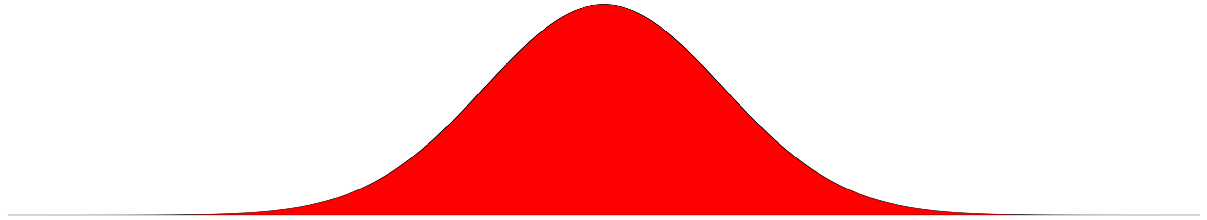
Ordination
A
A
y
x
Notes:
Next look for lines along which the variance is maximised, here is low

Slide 53
Ordination
B
A
A
y
B
x
Notes:
This is better

Slide 54
Ordination
C
B
A
A
y
B
x
C
Notes:
But this is best

Slide 55
Ordination
y
x
Notes:
We have our first new axis

Slide 56
Ordination
A
y
x
Notes:
Then we continue in same manner, but with requirement that subsequent axes must be orthogonal to previous axis (here there is only one possibility

Slide 57
Ordination
y
x
Notes:
Next data must be shifted and rotated to new space

Slide 58
Ordination
Notes:
Shift to make mean the orign (0, 0)

Slide 59
Ordination
Notes:
Rotate to form the new axes

Slide 60
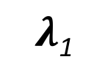
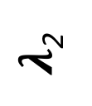
Ordination
$λ$₂
$λ$₁
Notes:
Can name new axes in numerical order from most to least variance

Slide 61
Ordination
Eigenvectors
New coordinates of points in N-dimensional space
Notes:
Eigenvectors represent coordinates of points in new space

Slide 62

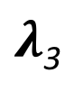
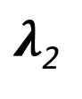
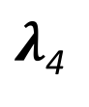
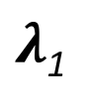
Ordination
Eigenvectors
New coordinates of points in N-dimensional space
$λ$₁
$λ$₂
$λ$₃
$λ$₄
Eigenvalues
New axes;$λ$₁$,λ$₂$,λ$₃$…λ$_{n}
Notes:
Eigenvalues represent both the axes (often dubbed principal components) and the variance they capture. Will always decrease from 1 to n.

Slide 63
Ordination
$λ$₁
$λ$₂
$λ$₃
$λ$₄
Eigenvalues
New axes;$λ$₁$,λ$₂$,λ$₃$…λ$_{n}
Notes:
Remember that goal of ordination is to reduce dimensionality

Slide 64
Ordination
$λ$₁
$λ$₂
Eigenvalues
New axes;$λ$₁$,λ$₂$,λ$₃$…λ$_{n}
Notes:
Can thus do so by ignoring higher low variance axes. Data now easier to visualise.

Slide 65
Visualisation (-spaces)

Slide 66
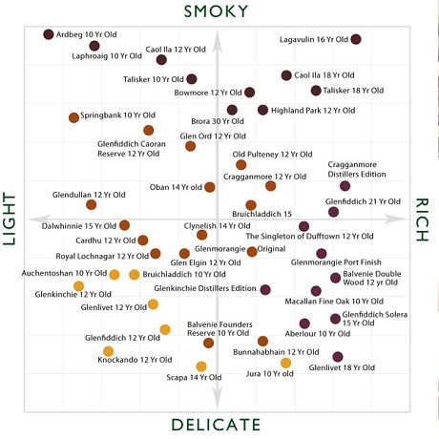
Visualisation (-spaces)
whiskyanalysis.com

Slide 67
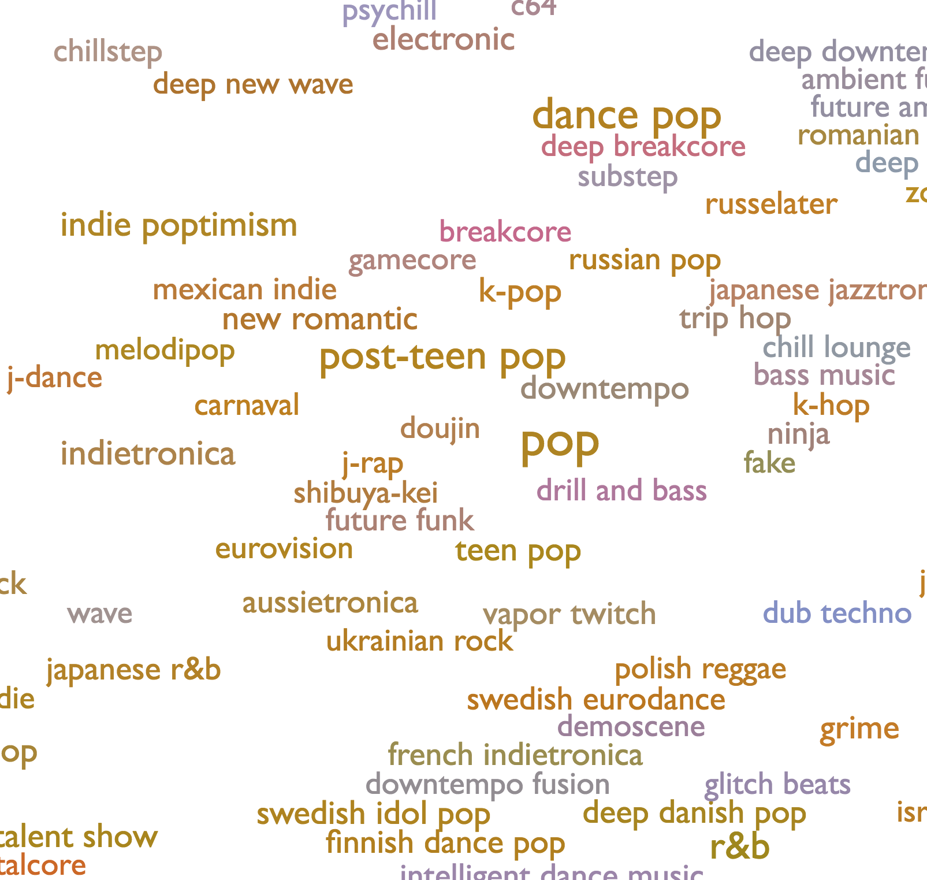
Visualisation (-spaces)
whiskyanalysis.com
everynoise.com

Slide 68
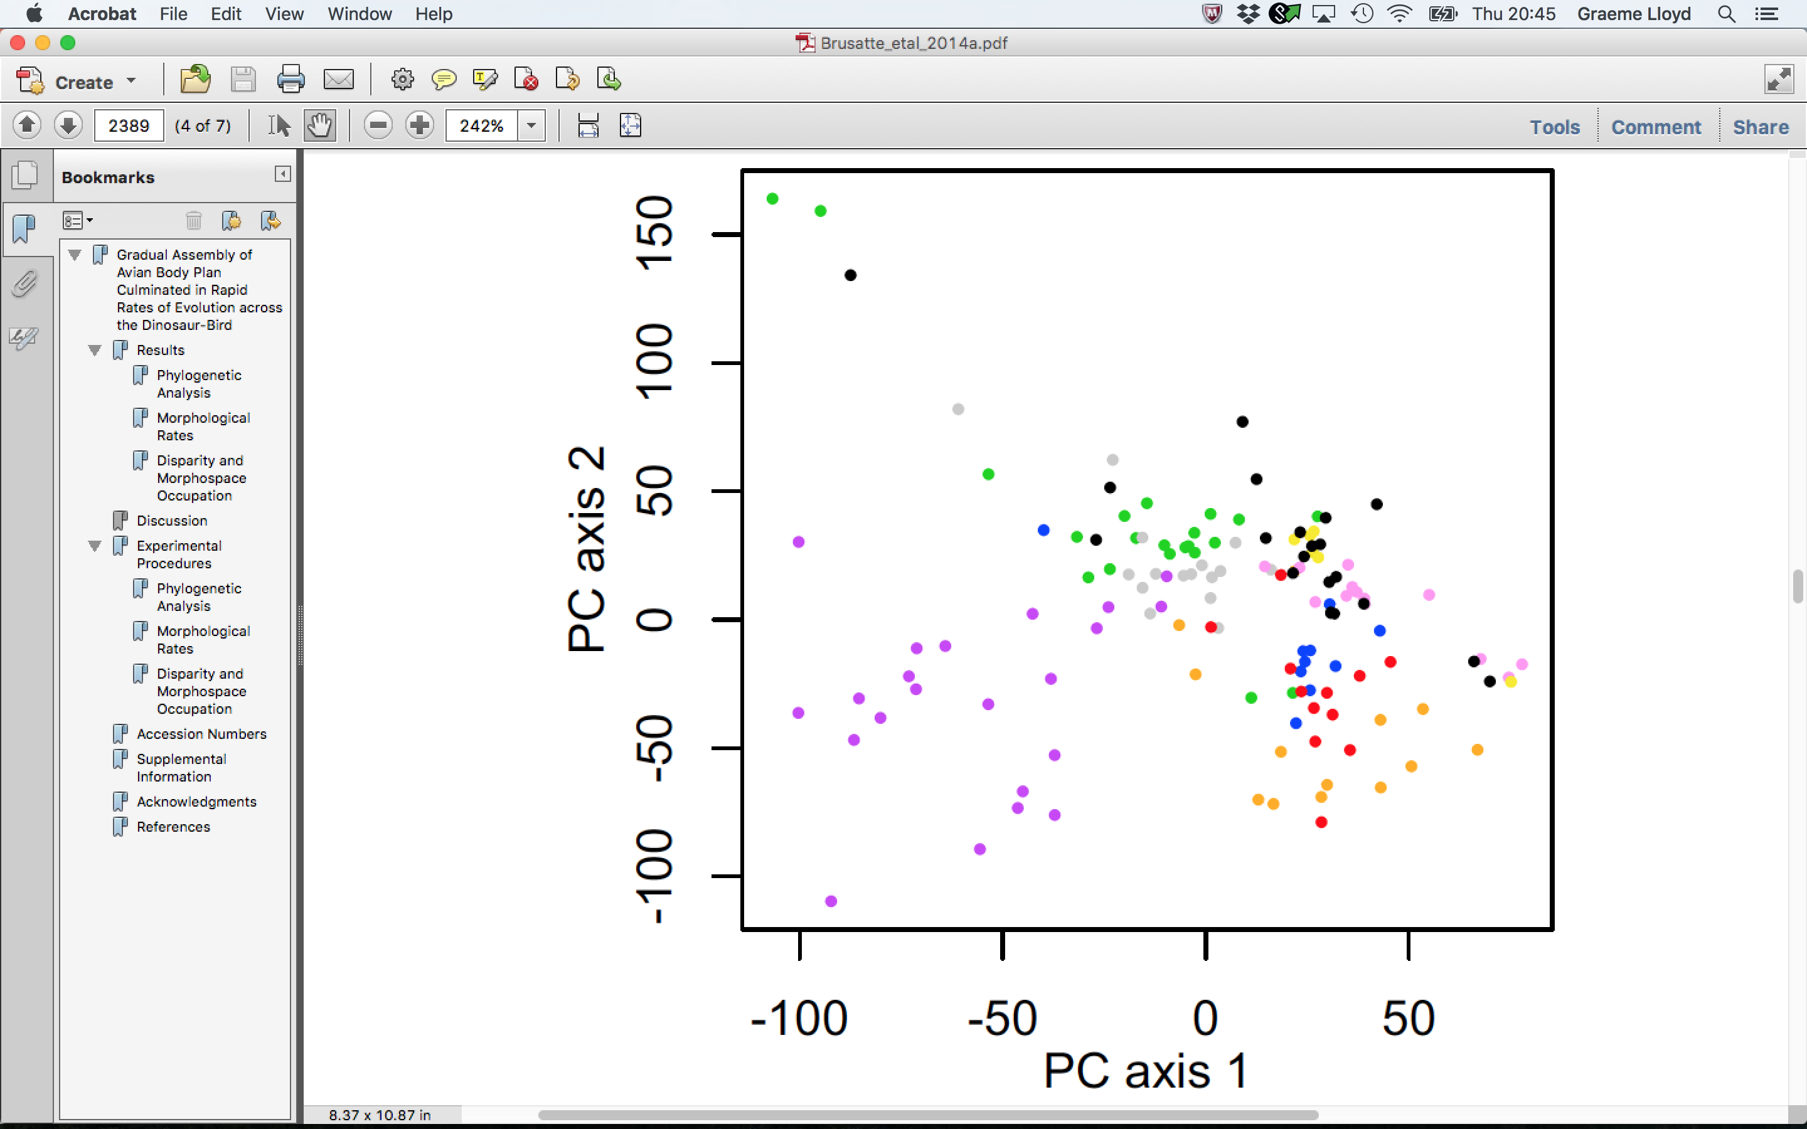
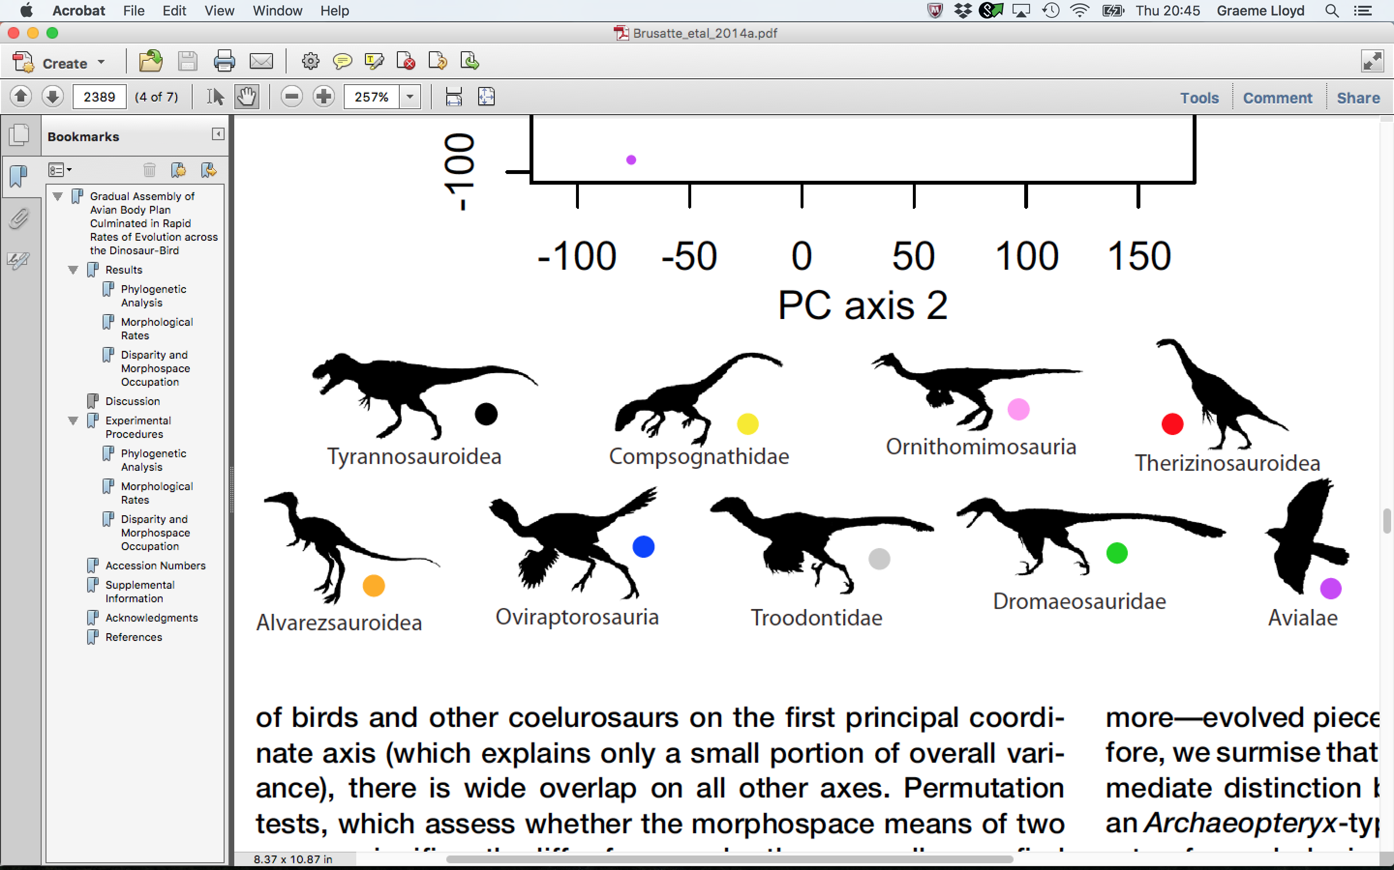
Visualisation (-spaces)
Brusatte et al 2014 Current Biology

Slide 69
Spherical statistics

Slide 70
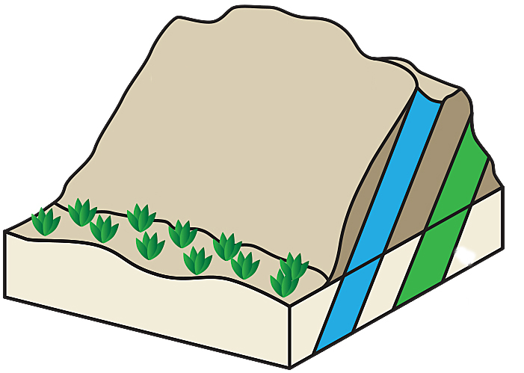
Spherical statistics
Strike
Azimuth
Dip
Plunge

Slide 71
Spherical statistics
Relative values are diagnostic of specific 3D distributions
λ₁ ≈ λ₂ ≈ λ₃ = Random (i.e., uniformly distributed)
λ₁ >> λ₂ ≈ λ₃ = Clustered about preferred value
λ₁ ≈ λ₂ >> λ₃ = Evenly distributed on great circle
λ₁ > λ₂ > λ₃ = Scattered on great circle but with preferred direction

Slide 72
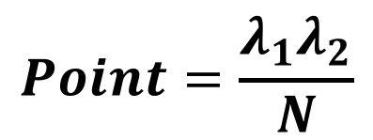
Spherical statistics
Point
$$Point=\frac{λ_{1}λ_{2}}{N}$$

Slide 73
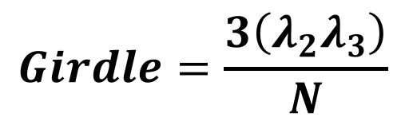
Spherical statistics
Point
$$Point=\frac{λ_{1}λ_{2}}{N}$$
Girdle
$$Girdle=\frac{3\left({λ_{2}λ}_{3}\right)}{N}$$

Slide 74
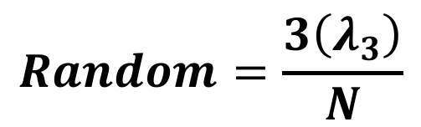
Spherical statistics
Point
$$Point=\frac{λ_{1}λ_{2}}{N}$$
Girdle
$$Girdle=\frac{3\left({λ_{2}λ}_{3}\right)}{N}$$
Random
$$Random=\frac{3\left(λ_{3}\right)}{N}$$

Slide 75
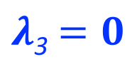
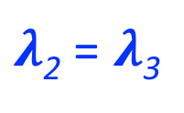

Spherical statistics
$λ$₃ $=0$
Point
Girdle
Point
$$Point=\frac{λ_{1}λ_{2}}{N}$$
Girdle
$$Girdle=\frac{3\left({λ_{2}λ}_{3}\right)}{N}$$
$λ$₂ = $λ$₃
$λ$₁ = $λ$₂
Random
$$Random=\frac{3\left(λ_{3}\right)}{N}$$
Random

Slide 76
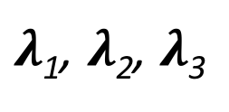
Spherical statistics
Eigenvalues
$λ$₁, $λ$₂, $λ$₃

Slide 77
Spherical statistics
Eigenvalues
$λ$₁, $λ$₂, $λ$₃
Shape parameter
K

Slide 78
Spherical statistics
Eigenvalues
$λ$₁, $λ$₂, $λ$₃
Shape parameter
K
Strength parameter
C

Slide 79
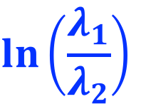
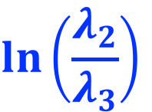
Spherical statistics
Clusters
K = 5
K = 2
K = 1
Eigenvalues
5
$λ$₁, $λ$₂, $λ$₃
4
$$\ln\left(\frac{λ_{1}}{λ_{2}}\right)$$
3
C = 6
Shape parameter
K = 0.5
Girdles
2
C = 4
K
1
C = 2
K = 0.2
Strength parameter
1
2
3
4
5
C
$$\ln\left(\frac{λ_{2}}{λ_{3}}\right)$$

Slide 80
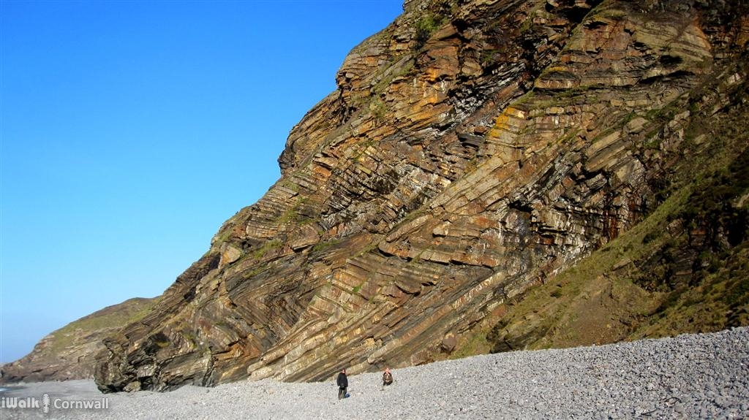
Spherical statistics

Slide 81

Spherical statistics

Slide 82
Spherical statistics
Eigenvalues for fold axes:
λ₁ = 0.571
λ₂ = 0.409
λ₃ = 0.020

Slide 83



Spherical statistics
Point
$λ$₃ $=0$
Girdle
$λ$₂ = $λ$₃
$λ$₁ = $λ$₂
Random

Slide 84


Spherical statistics
Clusters
Point
$λ$₃ $=0$
K = 1
Girdle
K = 5
K = 2
5
4
$$\ln\left(\frac{λ_{1}}{λ_{2}}\right)$$
3
C = 6
K = 0.5
Girdles
$λ$₂ = $λ$₃
$λ$₁ = $λ$₂
2
C = 4
1
C = 2
K = 0.2
1
2
3
4
5
$$\ln\left(\frac{λ_{2}}{λ_{3}}\right)$$
Random

Slide 85

Almost done
Source: xkcd

